Slide 1
Modeling concurrent functionality in Verilog
Verilog is a hardware description language, not a programming language.
Lines of code represent the behavior of real hardware.
Assignments are executed concurrently unless specifically noted otherwise.
Continuous assignment
Continuous Assignment with logical operators
Continuous assignment with conditional operators
Continuous assignment with delay

Slide 2
Continuous assignment
Verilog uses the keyword assign to denote a continuous signal assignment.
After this keyword, an assignment is made using the = symbol.
The left-hand side (LHS) of the assignment is the target signal and must be a net type.
The right-hand side (RHS) contains the input arguments and can contain nets, regs, constants, and operators.
A continuous assignment models combinational logic.
Any change to the RHS of the expression will result in an update to the LHS target net.
Each assignment will be executed concurrently and synthesized as separate logic circuits. Consider the following example.
assign X = A;
assign Y = B;
assign Z = C;

Slide 3
Continuous assignment
When simulated, these three lines of Verilog will make three separate signal assignments at the same time.
In Verilog, this functionality is identical to three separate wires. This description will be directly synthesized into three separate wires.

Slide 4
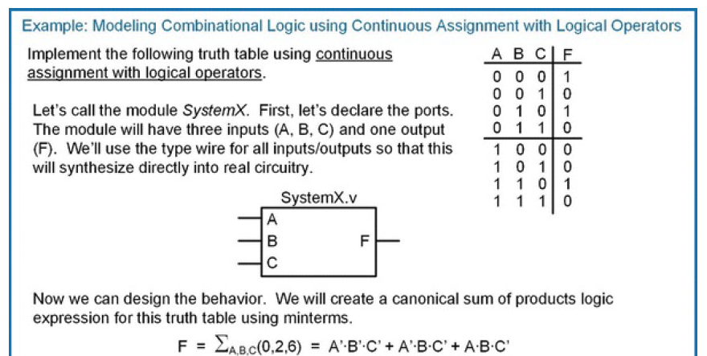
Continuous Assignment with logical operators

Slide 5
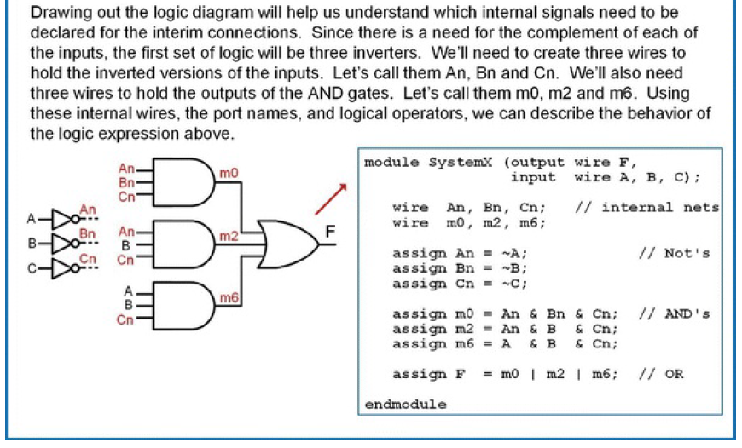
Continuous Assignment with logical operators

Slide 6
Continuous assignment with conditional operators
Logical operators are good for describing the behavior of small circuits; however, in the prior example, we still needed to create the canonical sum of products logic expression by hand before describing the functionality in Verilog
The true power of an HDL is when the behavior of the system can be described fully without requiring any hand design
The conditional operator allows us to describe a continuous assignment using Boolean conditions that affect the values of the result
In this approach, we use the conditional operator (?) in conjunction with the continuous assignment keyword assign.

Slide 7
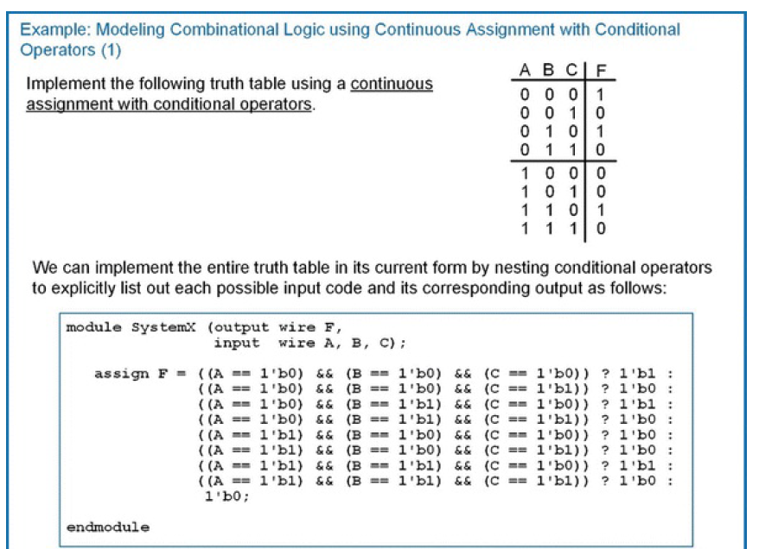
Continuous assignment with conditional operators

Slide 8
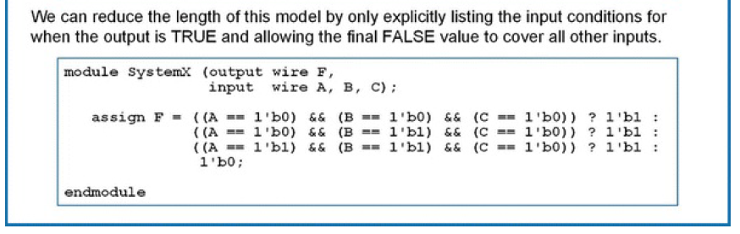
Continuous assignment with conditional operators

Slide 9
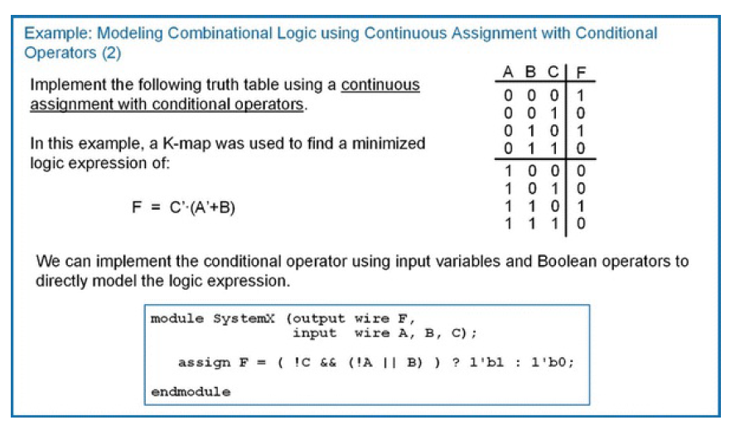
Continuous assignment with conditional operators

Slide 10
Continuous assignment with delay
Verilog provides the ability to model gate delays when using a continuous assignment. The # is used to indicate a delayed assignment.
For combinational logic circuits, the delay can be specified for all transitions, for rising and falling transitions separately, and for rising, falling, and transitions to the value off separately. A transition to off refers to a transition to Z.
If only one delay parameter is specified, it is used to model all delays.
If two delay parameters are specified, the first parameter is used for the rise time delay while the second is used to model the fall time delay.
If three parameters are specified, the third parameter is used to model the transition to off.
Parenthesis are optional but recommended when using multiple delay parameters.

Slide 11
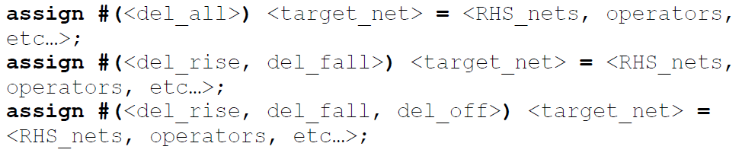
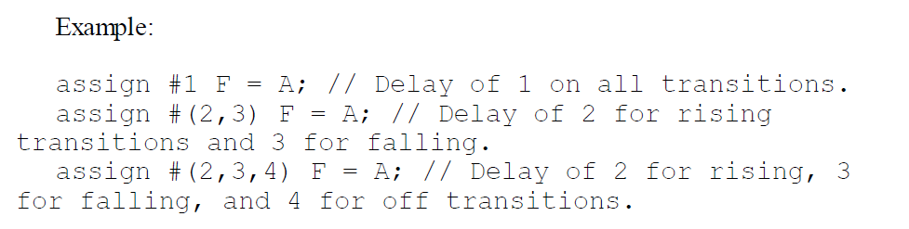
Continuous assignment with delay

Slide 12
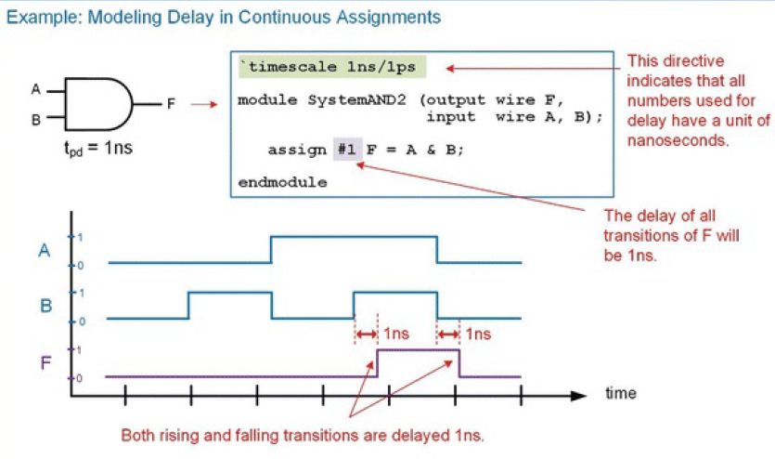
Continuous assignment with delay

Slide 13
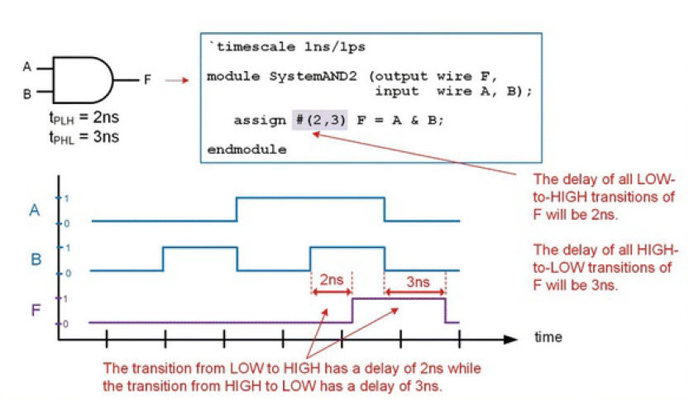
Continuous assignment with delay

Slide 14
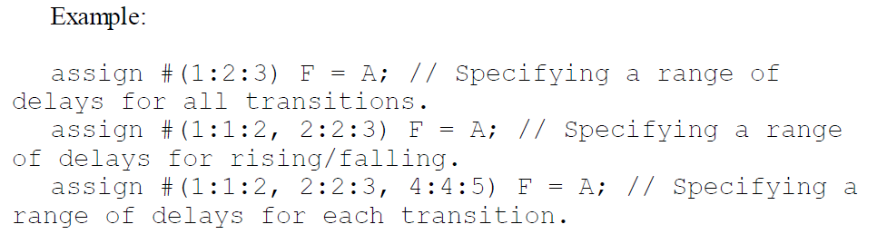
Continuous assignment with delay
Verilog also provides a mechanism to model a range of delays that are selected by a switch set in the CAD compiler.
Three delay categories can be specified: minimum, typical, and maximum. The delays are separated by a “:”.
The following is the syntax of how to use the delay range capability.
assign #(<min>:<typ>:<max>) <target_net> = <RHS_nets, operators, etc.…>;

Slide 15
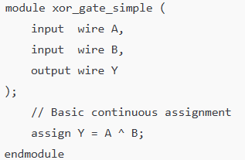
2-input XOR gate using different types of continuous assignment (assign) statements
Continuous Assignment
^ is the bitwise XOR operator.

Slide 16
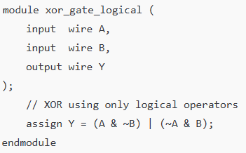
2-input XOR gate using different types of continuous assignment (assign) statements
2. Continuous Assignment with Logical Operators

Slide 17
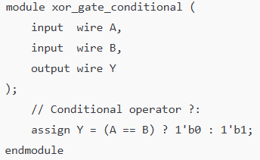
2-input XOR gate using different types of continuous assignment (assign) statements
3. Continuous Assignment with Conditional Operator

Slide 18
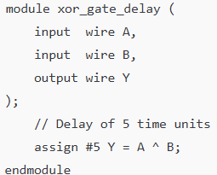
2-input XOR gate using different types of continuous assignment (assign) statements
4. Continuous Assignment with Delay

